Slide 1
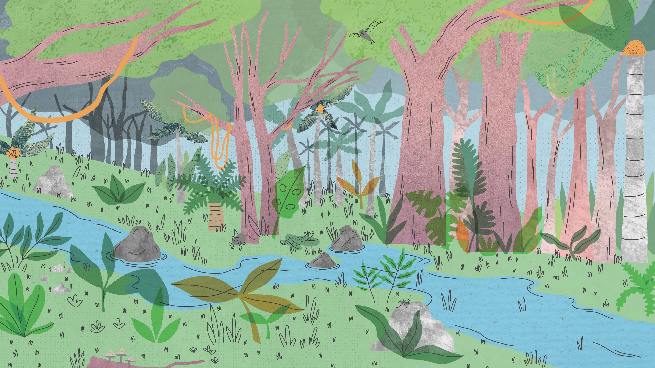

Health
gbif.org/health

Slide 2
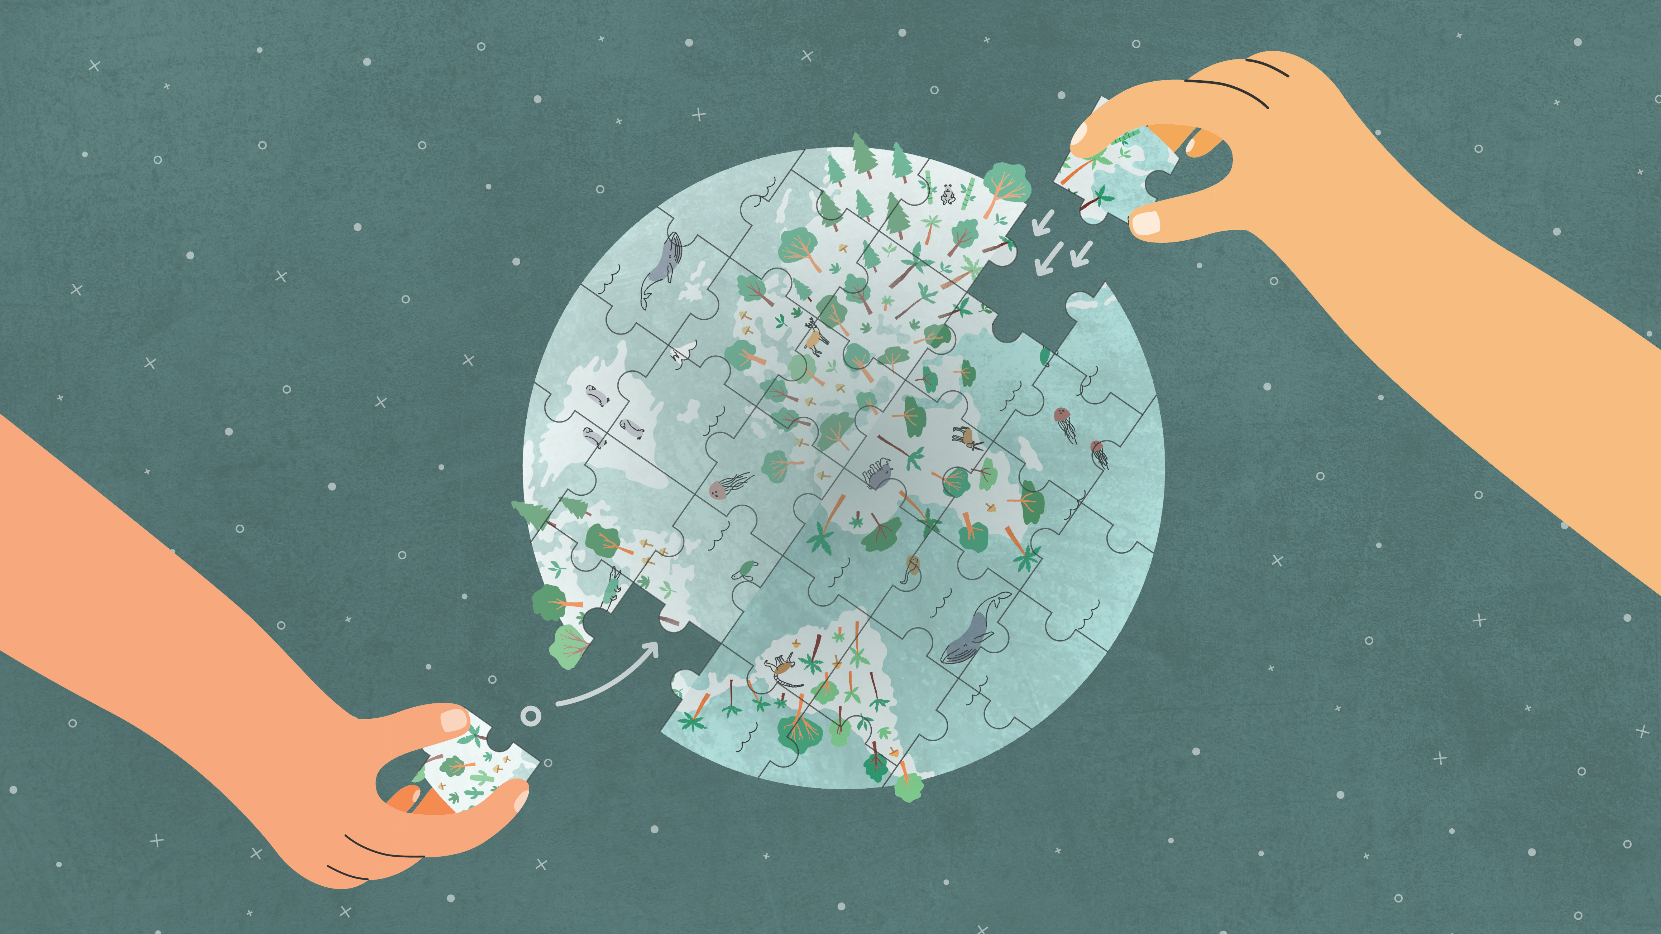
Climate change
gbif.org/climate

Slide 3
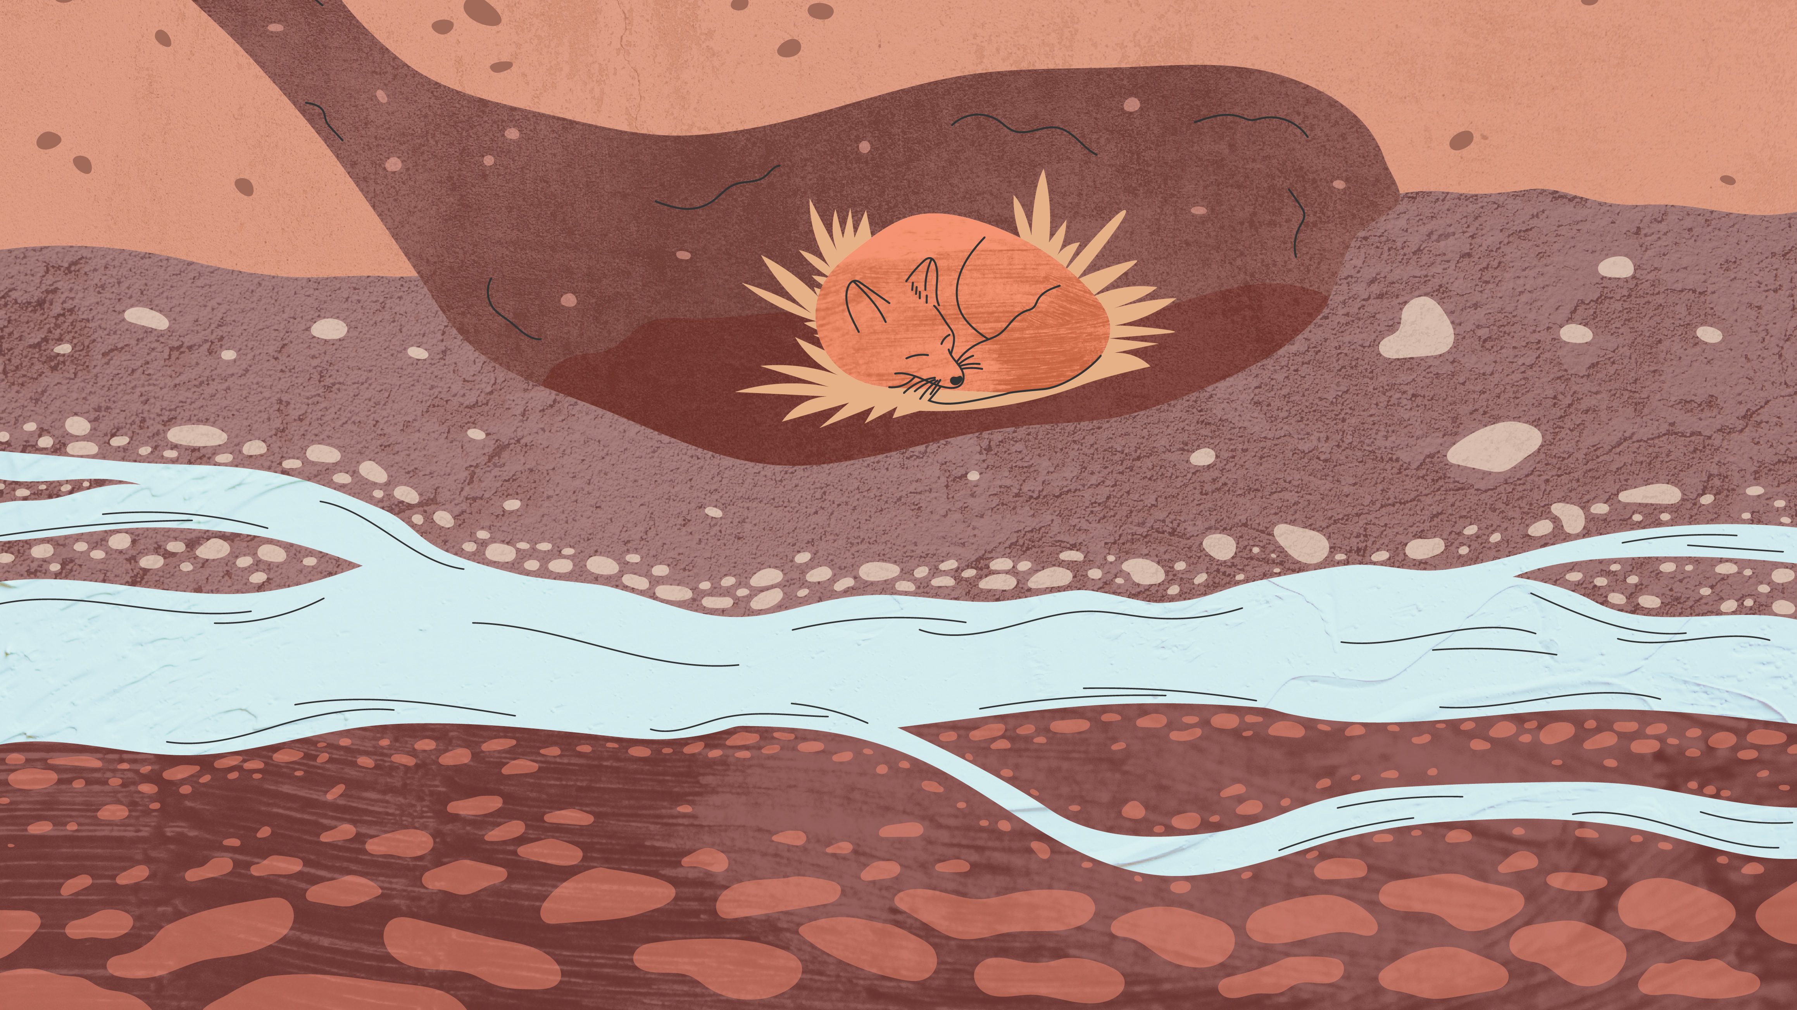
Conservation
gbif.org/conservation

Slide 4

DNA
gbif.org/dna

Slide 5
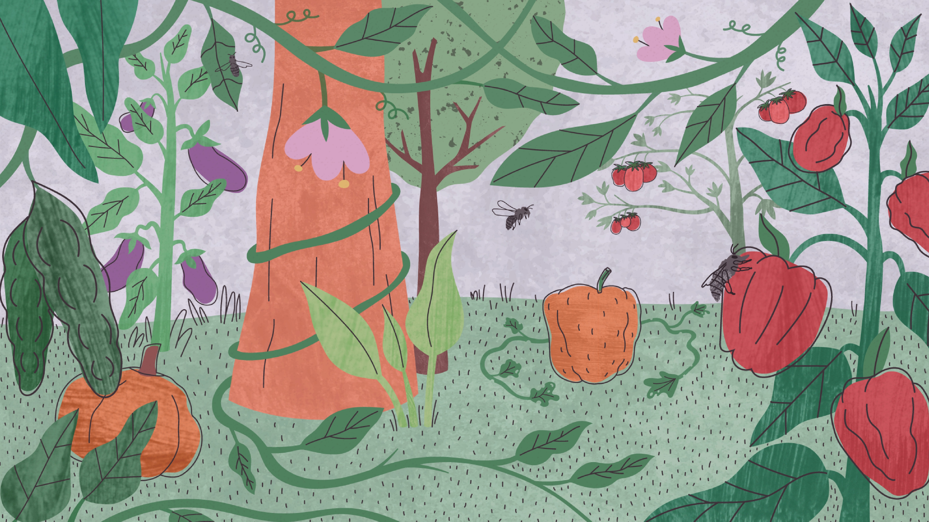
Food
gbif.org/food

Slide 6


Soil
gbif.org/soil

Slide 7


Invasives
gbif.org/invasives

Slide 8


Global Registry of Scientific Collections
gbif.org/scientific-collections

Slide 9
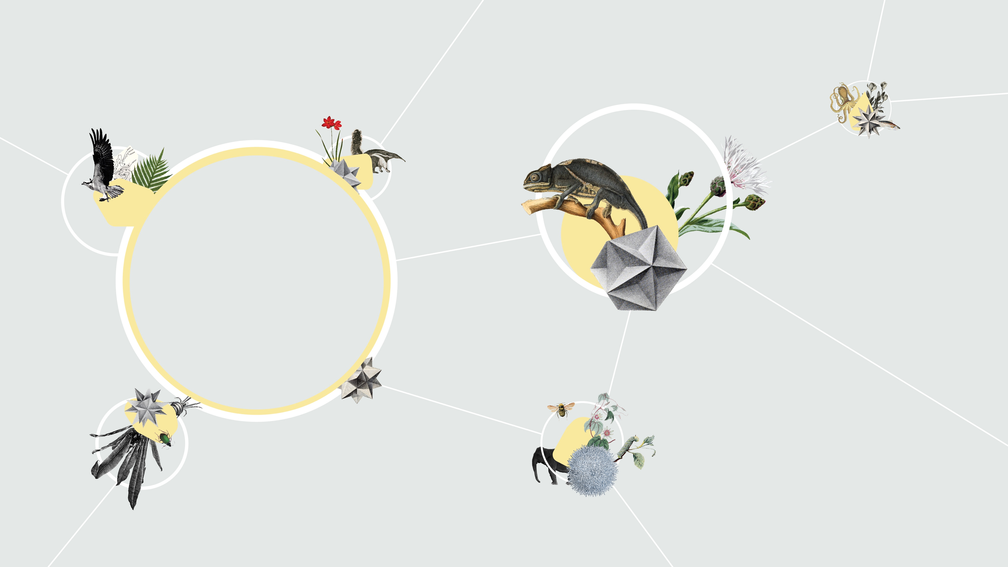

Hosted Portals
gbif.org/hosted-portals

Slide 10

Capacity Enhancement Support Programme
https://bit.ly/c-e-s-p

Slide 11

Capacity development framework
https://docs.gbif.org/capacity-development-framework/en/

Slide 12


Data Use Club
gbif.org/data-use-club

Slide 13

New data model
gbif.org/new-data-model

Slide 14

Phylogenetics
bit.ly/gbif-phylo

Slide 15

Technical support hours for GBIF nodes
bit.ly/gbif-phylo

Slide 16

Technical support hours for GBIF nodes
bit.ly/gbif-phylo

Slide 17


GB30 Australia 30th GBIF Governing Board Meeting
gb30.gbif.org

Slide 18

BID Biodiversity Information for development
gbif.org/bid

Slide 19


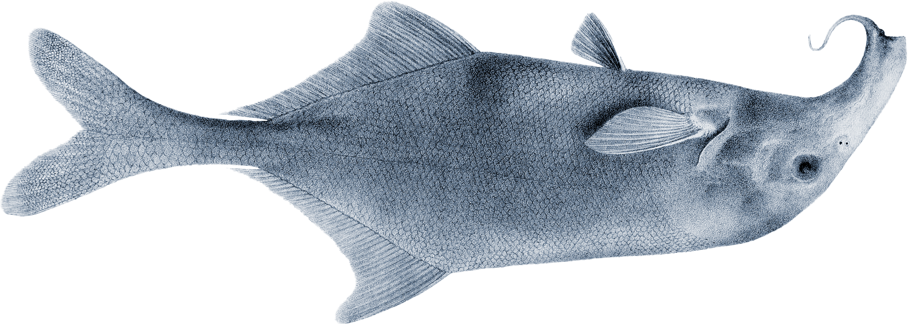
gbif.org/graduate-researchers-award

Slide 20


gbif.org/ebbe

